Slide 1
Shell Bootcamp 2024 3 Reflections for Week #3
Alvia Hussain
Date : 13-Sept-2024

Slide 2

About Me
If it doesn’t challenge you,
it doesn’t change you

Slide 3

My learnings from this week!

Slide 4
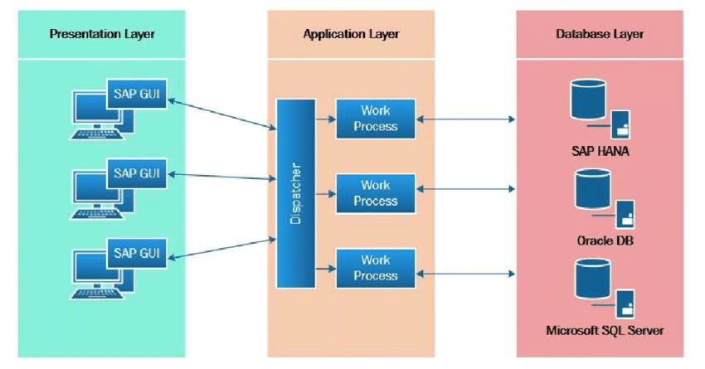
Learning 1 | My takeaways
Business Process (BP): A series of linked tasks aimed at delivering a service or product to clients and achieving organizational goals.
Key Functional Areas: Includes finance and accounting (FI), supply chain management (SCM), marketing and sales (MS), and human resources (HR), each with specific operations like marketing, sales, purchasing, logistics, and HR activities.
ERP Systems: Optimize and track these functions, integrating them into a single system to enhance efficiency and reduce costs.
SAP Modules: SAP, a leading ERP provider, offers modules such as FI (Financial Accounting), SD (Sales and Distribution), MM (Materials Management), and HR (Human Resources).
Three-Tier Architecture: SAP uses a three-tier architecture consisting of the GUI, application server, and database server.
SAP Projects and ABAP: SAP projects include implementation, support, rollout, and upgrade, following a structured methodology. SAP ABAP is the programming language used for customizing and extending SAP functionalities.

Slide 5
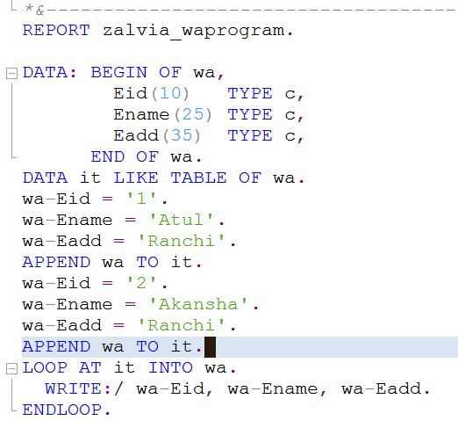
Learning 2 | My takeaways
HANA: Stands for High-Performance Analytic Appliance.
Operators and Operands: Operators are mathematical and comparative, while operands are variables used in operations.
ABAP Keywords: Identify statement types such as calling, controlling, declaration, definition, DB, event, and operational keywords.
Data Types and Syntax: Numeric (integer, float, packed decimal) and character (char, numeric char, date, time) data types. Statements end with a period, and integers default to zero. Packed decimal syntax: Data <variable name>(<length>) type P decimals <no>.
Open SQL and DDIC: Open SQL is database-independent and supports SAP but not DDL. The Data Dictionary (DDIC) creates or alters tables using domains and data elements.
Table Requirements and Types: Technical requirements for tables include naming conventions, field lists, delivery class, and technical settings. Domains define data types

Slide 6
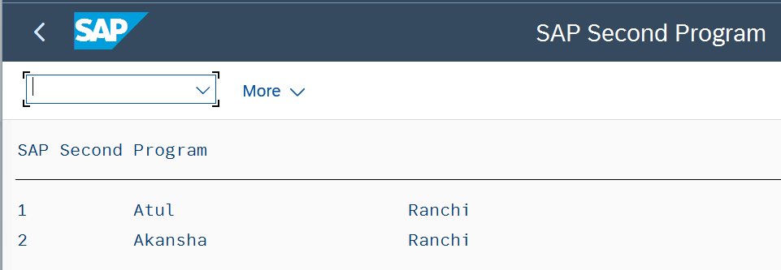
Learning 3 | My takeaways
Indexes: Improve the performance of select queries. Primary indexes are mandatory for custom tables (up to 16 per table), while secondary indexes (up to 9 per table) can be created for both standard and custom tables.
Commands: The command /O opens a new session without closing the current one, while /N opens a new session and closes the current one.
Internal Tables: Temporary collections of records used to fetch data from other tables into a program.
Declaration Syntax: Internal tables are declared using Data <internal table> like table of <work area>.
Field Declaration: Fields within internal tables can be declared using various syntaxes, such as Data <field name>(<length>) type <data type>, Data <field name> type <data elements>, or Data <field name> type <database table>-<field name>.
Buffering: Internal tables act as buffers, storing data temporarily for processing within the program.

Slide 7

Relevance of learnings for my organization

Slide 8
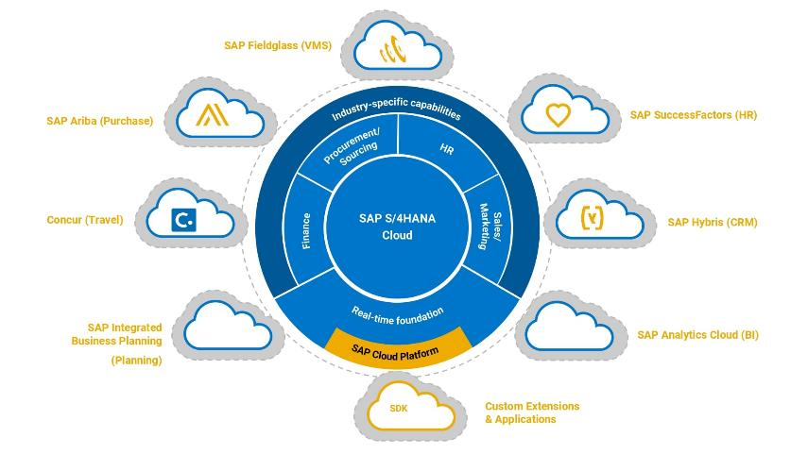
Learning 1 | Relevance for Shell
SAP S/4HANA: Crucial for Shell’s digital transformation, simplifying operations by consolidating around 30 ERP systems into a unified platform.
Enhanced Efficiency: This transition enhances data consistency, operational efficiency, and agility, enabling faster decision-making and cost reduction.
Deployment Strategy: Shell’s strategy includes deploying multiple SAP S/4HANA instances tailored to various business needs.
Cloud-Based Solution: Aiming for a fully cloud-based solution.
Process Alignment: This transformation aligns enterprise systems, streamlines processes, and simplifies data management.
Value Creation: Driving significant value for Shell.

Slide 9
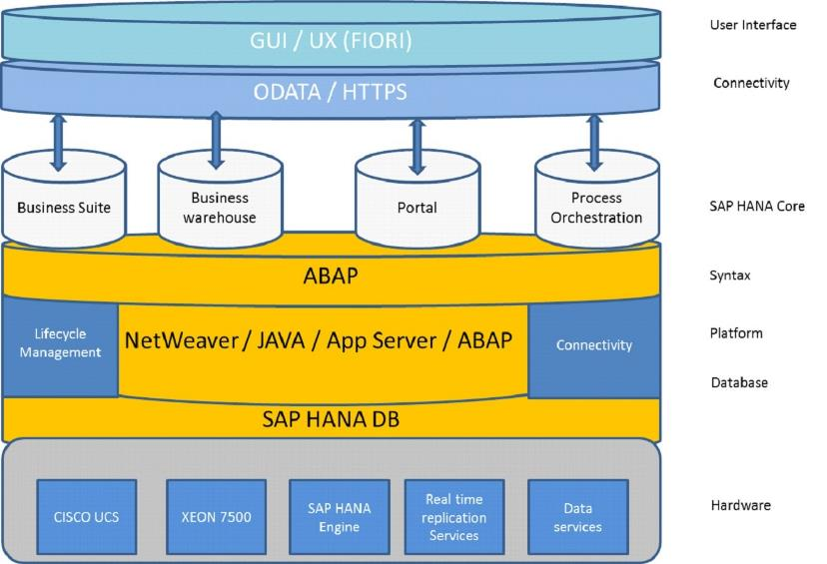
Learning 2 | Relevance for Shell
HANA’s Role: Essential for Shell’s digital transformation, consolidating around 30 ERP systems into a unified SAP S/4HANA platform.
Enhanced Efficiency: Improves data consistency, operational efficiency, and agility, enabling faster decision-making and cost reduction.
Deployment Strategy: Shell plans to deploy multiple SAP S/4HANA instances tailored to various business needs.
Process Alignment: Aligns enterprise systems, streamlines processes, and simplifies data management.

Slide 10
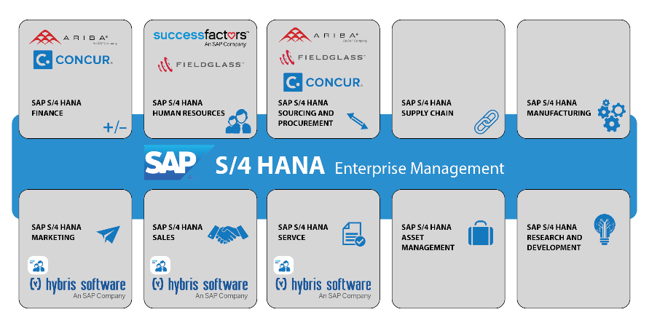
Learning 3 | Relevance for Shell
Indexes and internal tables are crucial for Shell's SAP S/4HANA implementation. Indexes enhance query performance, ensuring faster data retrieval, which is vital for Shell's large-scale operations.
Internal tables allow temporary data storage and manipulation within programs, facilitating efficient data processing and integration across various modules.
These tools help streamline operations, improve data management, and support Shell's goal of achieving a unified, agile, and efficient ERP.

Slide 11

Challenges in implementing learning

Slide 12
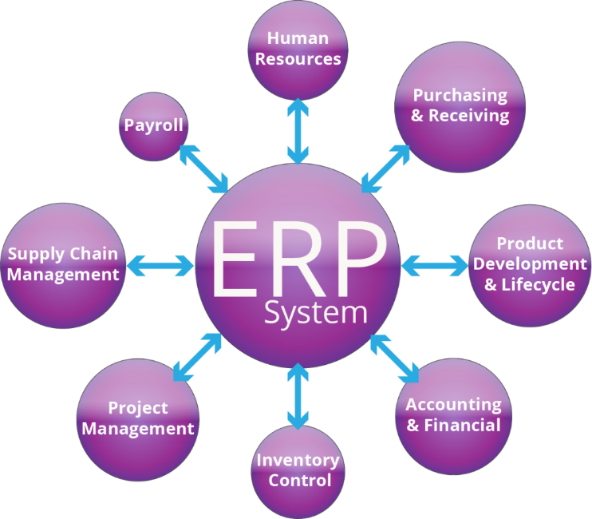
Challenge faced while implementing Learning 1
Complex Data Migration: Implementing SAP S/4HANA involves complex data migration, requiring extensive cleansing and validation.
Customization Challenges: Customizing existing functionalities to fit the new system adds to the complexity.
User Resistance: Common user resistance necessitates thorough training and change management.
Integration Difficulties: Integration with existing systems and third-party applications can pose difficulties.
Project Management: Effective project management is crucial to avoid delays and cost overruns.
Planning and Training: Addressing these challenges demands meticulous planning, clear communication, and robust training programs to ensure a smooth transition.

Slide 13
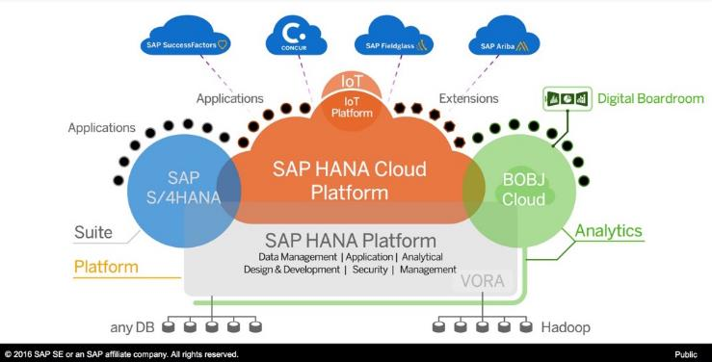
Challenge faced while implementing Learning 2
Complex Data Migration: Implementing SAP S/4HANA at Shell involves complex data migration, requiring thorough cleansing and validation to ensure consistency.
Customization Challenges: Customizing existing functionalities to fit the new system can be time-consuming.
User Resistance: Common user resistance necessitates extensive training and change management.
Integration Difficulties: Ensuring seamless integration with existing systems and third-party applications can be difficult.
Project Management: Effective project management is crucial to avoid delays and cost overruns.

Slide 14
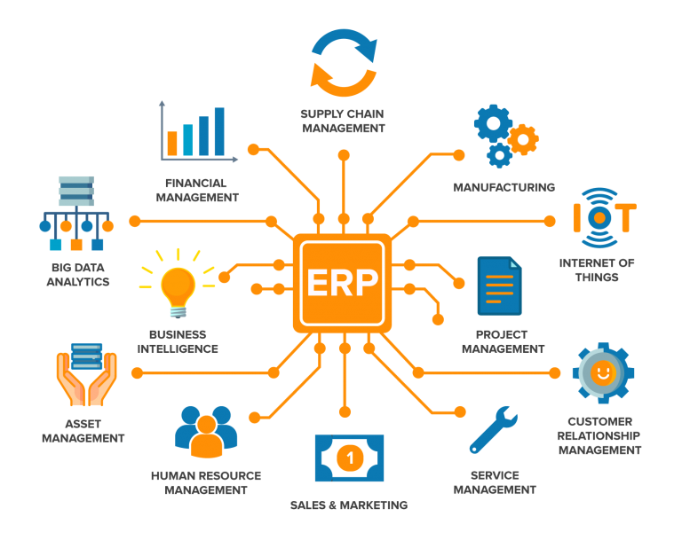
Challenge faced while implementing Learning 3
Customization Challenges: Customizing existing functionalities to fit the new system can be time-consuming.
Integration Difficulties: Ensuring seamless integration with existing systems and third-party applications can pose difficulties.
Planning and Training: Addressing these challenges demands meticulous planning, clear communication, and robust training programs.

Slide 15

Action Plan

Slide 16
My Action Plan for this Week
Actions
Timeline
Status
Practicing SAP ABAP codes, revising the workbench topics
Saturday - Practice codes
Sunday – ECC & S/4 HANA
Completed

Slide 17

Learning is also Fun!

Slide 18
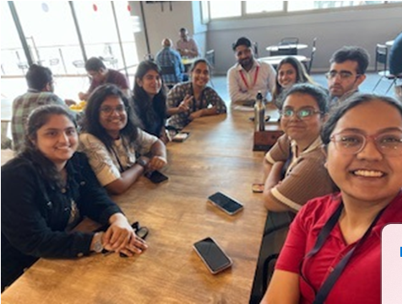
Learning is also Fun!
We had a great time learning various topics, especially the technical aspects, which we really enjoyed. Sir even took us out for lunch. Ali sir is truly amazing; his teaching skills are commendable, making it feel like everything gets imbibed into our brains effortlessly. We don’t need to put much effort into revising because we understand how things work so well. The hands-on experience with the tech stacks before actually working on them made us comfortable with the environment

Slide 19

Summary
ERP, SAP, ABAP: Gained knowledge in ERP systems, SAP, and ABAP programming.
S/4 HANA and BTP: Learned about SAP S/4HANA and Business Technology Platform (BTP), including selection screens.
Migration: Understanding the process of migrating from ABAP to HANA.

Slide 20
Thank You

